Slide 1

MAULANA AZAD
NATIONAL INSTITUTE OF TECHNOLOGY
BHOPAL – 462003 (INDIA)
Hate Speech detection
Minor Project PPT
Submitted by:
Mohit Verma | 201112244
Mihir Mall | 201112226
Aditya Kudroli | 201112232
Koushik Barde | 201112231
Under the Guidance of
Dr. Sri Khetwat Saritha
DEPARTMENT OF COMPUTER SCIENCE & ENGINEERING
Session: 2022-2023

Slide 2
Outline
Introduction
Literature Survey
Research Gaps Identified
Proposed Framework
Problem Definition
Objective
Proposed Architecture
Methodology
Results And Discussions
Conclusion And Future Works
Project Scheduling
References

Slide 3
Introduction
Hate speech targets disadvantaged social groups.
Offensive language is not always hate speech.
Context is important in determining hate speech.
African Americans use the term "LOSER" in everyday language online.
Teenagers use homophobic slurs while playing video games.
There is no formal definition of hate speech.
Natural Language Processing (NLP) used for hate speech detection.
Machine Learning (ML) and Deep Learning (DL) methods used.
Transfer learning approach proposed using unsupervised pre-trained model BERT. New supervised fine-tuning strategies introduced.

Slide 4
Literature Survey
Thomas Davidson, Dana Warmsley , Michael Macy, Ingmar Weber , 2017[1], The authors evaluate different machine learning models, including Support Vector Machines (SVMs) and deep neural networks, and compare their performance in detecting hate speech on Twitter.
Mozafari , Marzieh and Farahbakhsh , Reza and Crespi, Noel , 2020[2] , used the BERT model, which is pre-trained on a large corpus of text data, to fine-tune a hate speech detection model. They also analyze the characteristics of hate speech, including the types of words and topics commonly used. After some modification in the BERT model they found that there BERT classification model perform more accurate then the BERT.
Aluru , Sai Saketh and Mathew, Binny and Saha, Punyajoy and Mukherjee, Animesh, 2020, The paper reviews various approaches to multilingual hate speech detection, including transfer learning and cross-lingual embedding techniques. Overall, the paper provides valuable insights into the state-of-the-art in multilingual hate speech detection using deep learning models. The authors propose three deep learning models: a Multilingual Convolutional Neural Network (MCNN), a Multilingual Recurrent Neural Network (MRNN), and a Multilingual Bidirectional Encoder Representations from Transformers (MBERT). And he found that MBERT performs the best.

Slide 5
Research Gaps
The previous research paper lack in the field of subjectivity in identifying hate speech.
The Limited dataset used for training and evaluation.
Fixed number of models is used in all research paper. Lack of comparison in the models.
Paper has binary classification hate speech and not hate speech.
Study only focused in English language Hate speech data set.
Model architecture and hyper parameter not explained in detail.
Limited evaluation metrics used in the study.

Slide 6
Problem Definition
The previous research paper lack in the field of subjectivity in identifying hate speech.
Limited dataset used for training and evaluation.
Fixed number of models is used in all research paper. Lack of comparison in the models.
Paper has binary classification hate speech and not hate speech.
Model architecture and hyperparameters not explained in detail.

Slide 7
Objectives
The previous research paper lack in the field of subjectivity in identifying hate speech but in our research paper we uses Twitter CrowdFlower data set. The intercoder agreement score provided by CF is 92%, and the majority decision for each tweet is used to assign a label.
Dataset size is of good range which is 25k tweets
Five different models are proposed and on that basis comparison is done
Previously only two classes were used hate speech and not-hate speech but we uses three classes hate speech, offensive and neither
All the models used are explained with flow chart

Slide 8
Proposed Architecture
Traditional
ML classifiers
NLP
(n-grams, POS,
TF-IDF)
Ensemble
Classifiers
Merged dataset
(HASOC + ALONE)
BERT
Embedding
DNN
Classifiers
Fast Text
Embedding

Slide 9
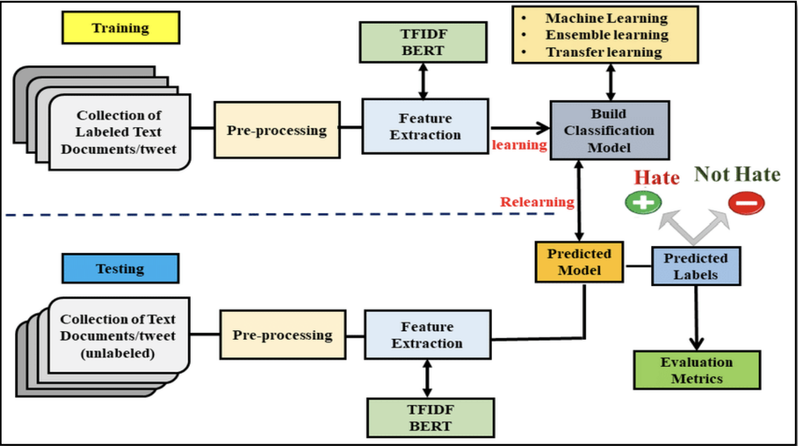

Slide 10
Models Used
Model No 1 :- LR + BERT + SVM + Pipeline System Model
Logistic Regression model is combined with BERT and SVC for hate speech detection
BERT generates embeddings of input text, fed to SVC for prediction
Pipelining combines LR, SVM, and BERT outputs for improved accuracy and efficiency
Combination of LR and SVM is a technique called stacked ensemble or ensemble learning
Stacked ensemble combines outputs from individual models as input to a meta-learner
Meta-learner combines individual model outputs to make final prediction
Twitter API used to search for tweets containing lexicon terms
CrowdFlower workers manually coded 25k tweets for training classifier
Final model achieves state-of-the-art performance in detecting hate speech.

Slide 11
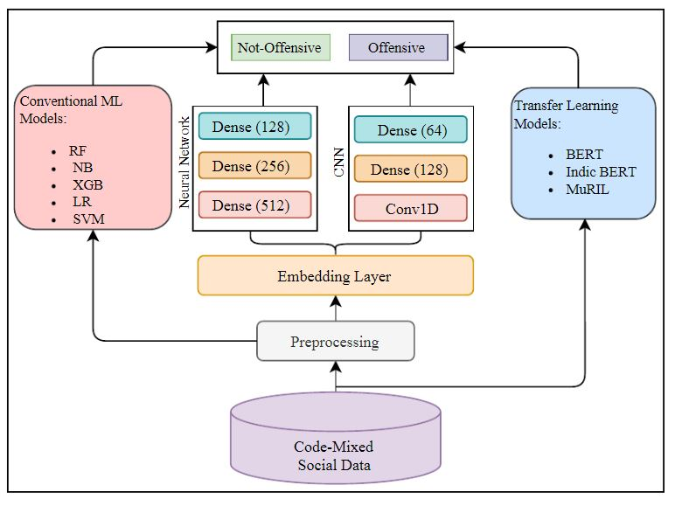
LR + BERT + SVM + Pipeline System Model System Flowchart & Overview

Slide 12
Model No 2 :- LSTM + BERT + SVM System Model
The LSTM(RNN) + BERT + SVC model combines the strengths of LSTM, BERT, and SVC algorithms for hate speech detection.
LSTM captures the sequential nature of text data, BERT provides contextual representation of words, and SVC is used for classification.
The model utilizes hidden states produced by LSTM layer to get contextualized representations using BERT layer.
These representations are then fed into an SVC classifier for final prediction.
The model achieves state-of-the-art performance on hate speech detection tasks.
It is capable of capturing the nuances of language and context.
The model is a hybrid model that combines multiple algorithms to achieve high performance.
LSTM layer helps to handle the sequential nature of text data.
BERT layer is responsible for providing contextualized representations of words.
SVC classifier is used for final prediction.

Slide 13
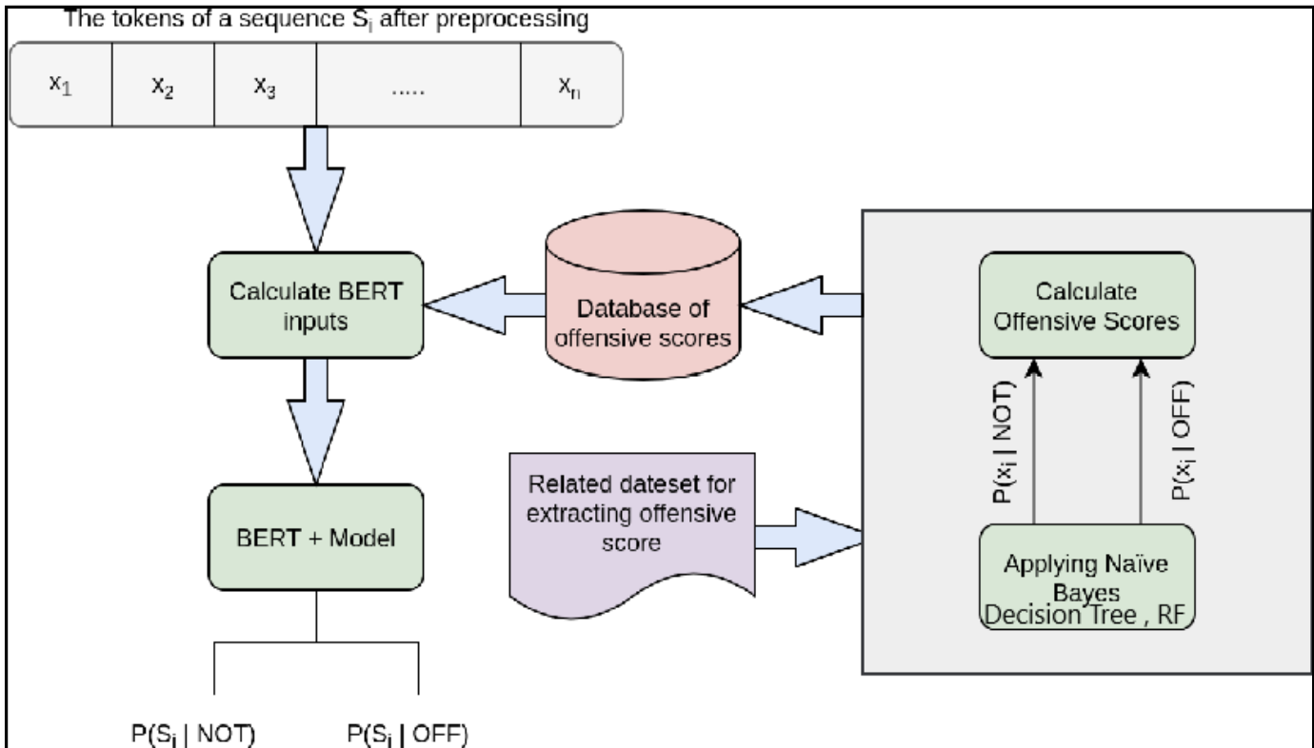
Naïve Bayes/Decision Tree/Random Forest+ BERT+ Pipeline System Model Flowchart

Slide 14
Model No 3 :- Naïve Bayes + BERT + Pipeline System Model
Naive Bayes + BERT + Pipeline model for hate speech detection
Combines Naive Bayes algorithm with BERT model
Naive Bayes calculates probability, BERT extracts semantic information
Accurate and efficient hate speech classification
Pipeline used for combining and improving accuracy and efficiency
Model No 4 :- Decision Tree + BERT + Pipeline System Model
Decision Tree + BERT + Pipeline model for hate speech detection.
Uses decision tree algorithm with BERT representation.
Decision tree trained on features from BERT model.
Classifies text as hate speech based on linguistic patterns.
Pipelining used for accuracy, efficiency, and model strengthening

Slide 15
Model No 5 :- Random Forest + BERT + Pipeline System Model
The Random Forest + BERT + Pipeline model is a hybrid model for hate speech detection.
The model combines a Random Forest algorithm and a pre-trained BERT language model.
The BERT model is used to extract features from the text input.
The features extracted from BERT are fed into the Random Forest classifier.
The model achieves high accuracy by leveraging the ability of BERT to encode the context of the text.
The Random Forest classifier can handle noisy data.
Pipelining is used to combine all for increasing accuracy and efficiency & strengthening model.
The model is effective in detecting hate speech.
The model is useful in dealing with the problem of context sensitivity.
The model can be used in multilingual hate speech detection.

Slide 16
Datasets
Dataset :Twitter CrowdFlower[1]
The authors use the Hatebase.org lexicon to identify hate speech in a sample of tweets from 33,458 Twitter users. They extract 85.4 million tweets and manually code a random sample of 25k tweets using CrowdFlower workers.
The authors then train a classifier using features extracted from these tweets. The CrowdFlower workers were asked to label tweets as hate speech, offensive but not hate speech, or neither. The intercoder agreement score is 92%, and the majority decision is used to assign a label.
The authors construct features from these tweets and use them to train a classifier. In summary, the authors use a hate speech lexicon to identify hate speech in tweets, manually code a sample of tweets using CrowdFlower workers, and train a classifier using features extracted from these tweets.
The results show that only 5% of tweets were coded as hate speech by the majority of coders, and only 1.3% were coded unanimously, demonstrating the imprecision of the Hatebase lexicon. The majority of the tweets were considered to be offensive language, and the remainder were considered to be non-offensive.

Slide 17
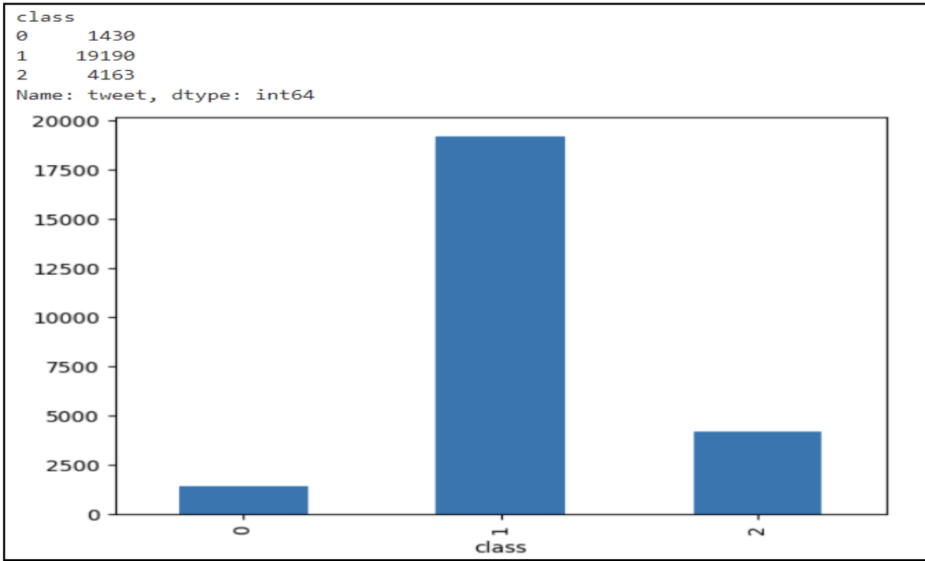
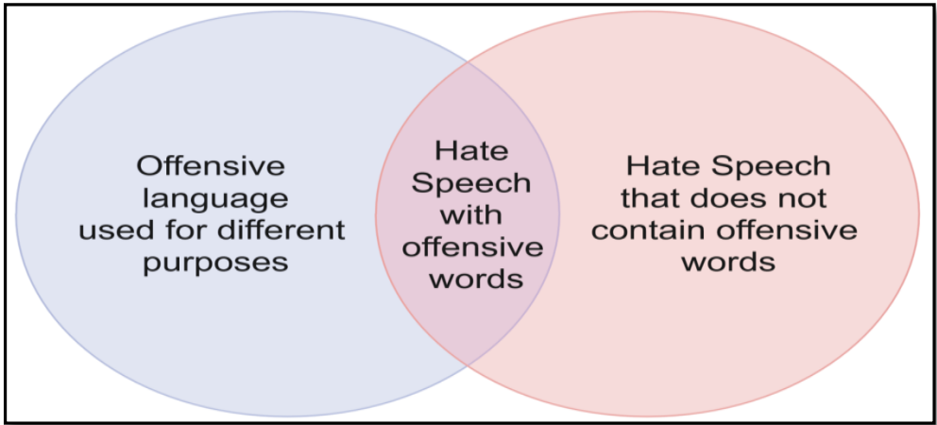
Ternary Classification in Labeled
dataset showing Three Classes
Dataset Description

Slide 18
Result And Discussion
Highest Accuracy | Random Forest + BERT | Least Accuracy | LSTM + BERT + SVM
Highest Precision | Decision Tree + BERT | Least Precision | LSTM + BERT + SVM
Highest Recall | Random Forest + BERT | Least Recall | LSTM + BERT + SVM
Highest F1-Score | Random Forest + BERT | Least F1-Score | Naïve Bayes + BERT
Models with Highest and Least value of Result Parameters

Slide 19
 | Model | Accuracy | Precision | Recall | F1Score
1. | LR + BERT + SVM + Pipeline | 82.45 | 0.80 | 0.82 | 0.78
2. | LSTM + BERT + SVM | 77.30 | 0.76 | 0.77 | 0.74
3. | Naïve Bayes + BERT | 78.94 | 0.77 | 0.78 | 0.70
4. | Decision Tree + BERT | 84.43 | 0.86 | 0.84 | 0.84
5. | Random Forest + BERT | 85.45 | 0.83 | 0.85 | 0.82
Result Table showing Description of all Output/Result Parameter
Comparitive Study
Model | Accuracy | Precision | Recall | F1Score
Random Forest + BERT | 85.45 | 0.83 | 0.85 | 0.82
LR + SVM + Pipeline[1] | 82.45 | 0.80 | 0.82 | 0.78

Slide 20
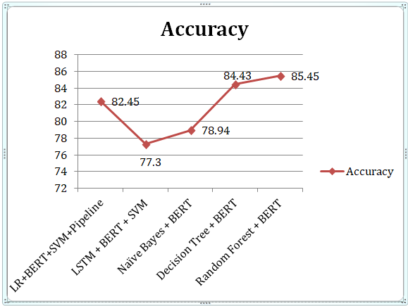
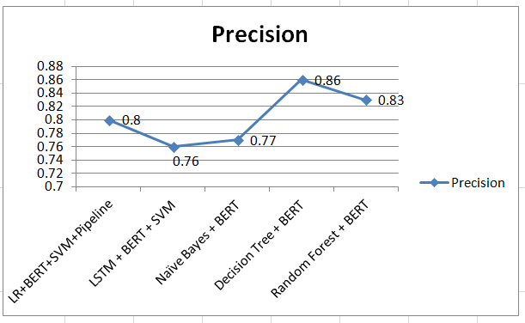
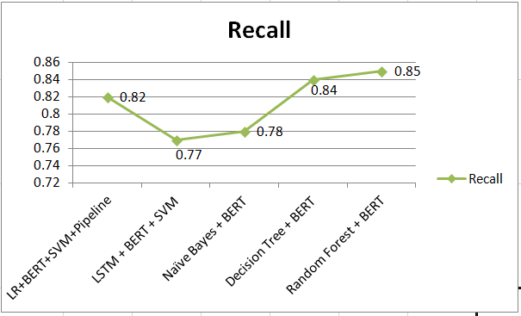
Accuracy Graph between all 5 Models
Precision Graph between all 5 Models
Recall Graph between all 5 Models

Slide 21
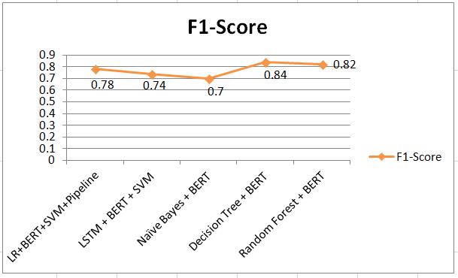
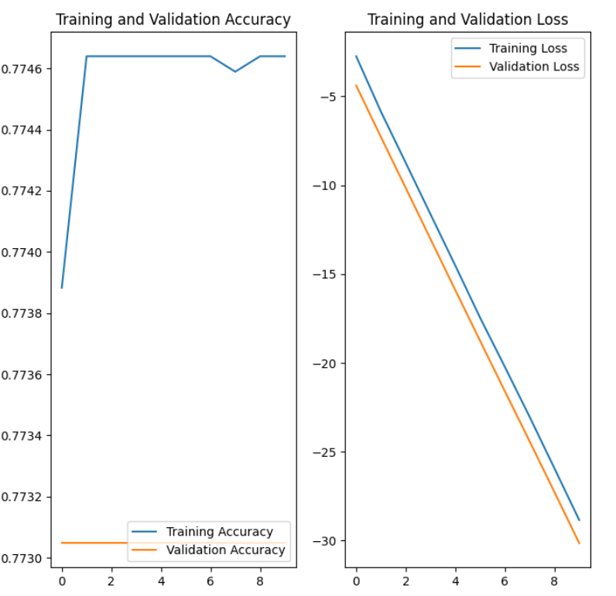
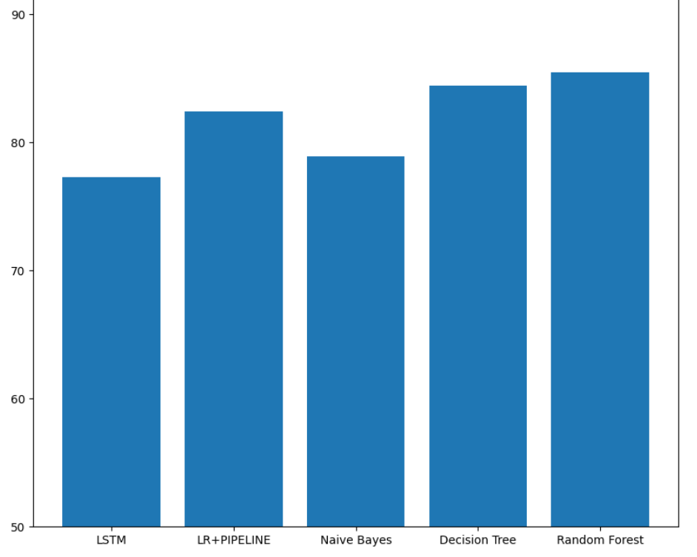
F1-Score Graph between 5 Models
Training & Validation Accuracy/Loss Graph
Comparison Graph between all 5 Models

Slide 22
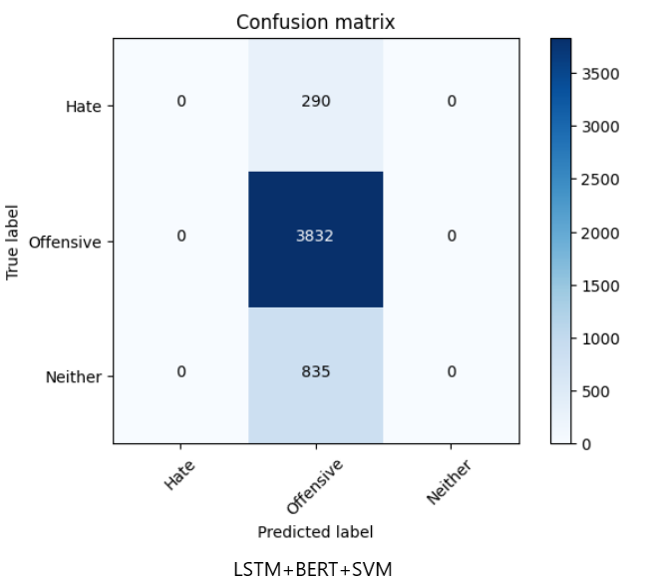
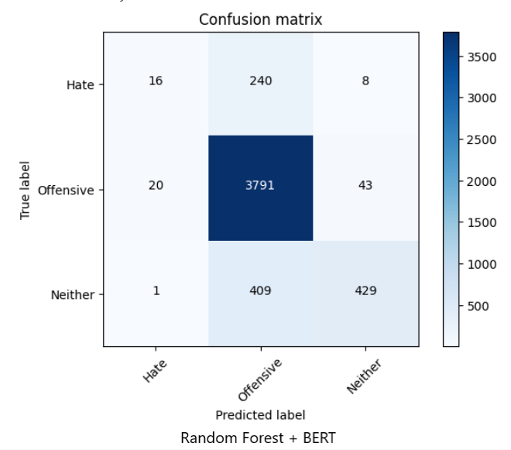
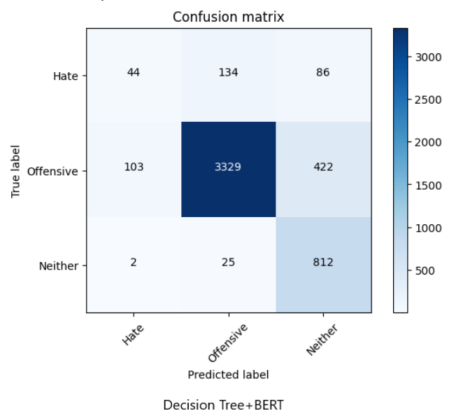
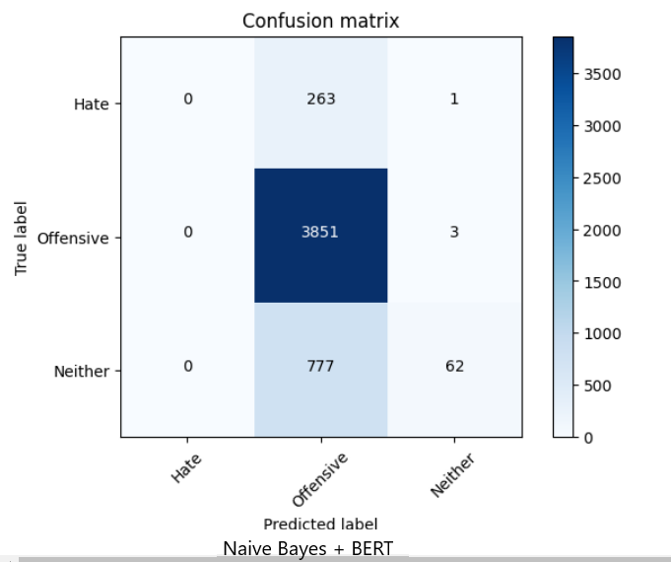
Confusion Matrix

Slide 23
Conclusion
The challenges of accurately identifying hate speech from offensive language are discussed, highlighting the potential misidentification of hate speakers and failure to differentiate between the two. A transfer learning approach using pre-trained language model BERT is proposed, showing improved performance in hate speech detection. The model also has the ability to detect biases in datasets.
Future Work
Future research in hate speech detection should focus on addressing the problem of context sensitivity, developing more nuanced approaches that take into account cultural factors, and improving accuracy. Additionally, it is important to consider the ethical implications of automated hate speech detection and explore questions around issues such as bias, privacy, and freedom of speech. To ensure fairness, methods that address bias in the models should be developed. Moreover, user-centered approaches and designing interventions that target hate speech producers can be more effective. Incremental learning and developing models that can adapt to new types of hate speech can improve the effectiveness of detection. Finally, detecting hate speech in non-English text is essential as it is prevalent in various languages.

Slide 24
Project Scheduling
 | January | February | March | April
Proposed problem | ✅
Review paper | ✅ | ✅
Implementation work |  |  | ✅
Implementation paper |  |  | ✅
Report submission |  |  |  | ✅

Slide 25
References
[1] Davidson, Thomas and Warmsley, Dana and Macy, Michael and Weber, Ingmar “Automated Hate Speech Detection and the Problem of Offensive Language”, Proceedings of the international AAAI conference on web and social media, 11, 512—515, 2017 2.
[2] Mozafari, Marzieh and Farahbakhsh, Reza and Crespi, Noel, “A BERT-based transfer learning approach for hate speech detection in online social media”, Complex Networks and Their Applications VIII: Volume 1 Proceedings of the Eighth International Conference on Complex Networks and Their Applications COMPLEX NETWORKS 2019 8, 928—940, 20203.
[3] Aluru, Sai Saketh and Mathew, Binny and Saha, Punyajoy and Mukherjee, Animesh, “Deep learning models for multilingual hate speech detection”, arXiv preprint arXiv:2004.06465, 20204.
[4] Abro, Sindhu and Shaikh, Sarang and Khand, Zahid Hussain and Zafar, Ali and Khan, Sajid and Mujtaba, Ghulam, “Automatic hate speech detection using machine learning: A comparative study”, International Journal of Advanced Computer Science and Applications, 11, 8, 20205.
[5] Rottger, Paul and Vidgen, Bertram and Nguyen, Dong and Waseem, Zeerak and Margetts, Helen and Pierrehumbert, Janet B, “HateCheck: Functional tests for hate speech detection models”, arXiv preprint arXiv:2012.15606, 20206.
[6] Mnassri, Khouloud and Rajapaksha, Praboda and Farahbakhsh, Reza and Crespi, Noel, “BERT-based Ensemble Approaches for Hate Speech Detection”, GLOBECOM 2022-2022 IEEE Global Communications Conference, 4649—4654, 2022

Slide 26
THANK YOU

